Slide 1
Demand Response with GridLAB-D

Slide 2
Presentation Overview
Part 1: What is Demand Response (DR)?
Part 2: The Wide World of DR
Part 3: Implementing DR in GridLAB-D

Slide 3
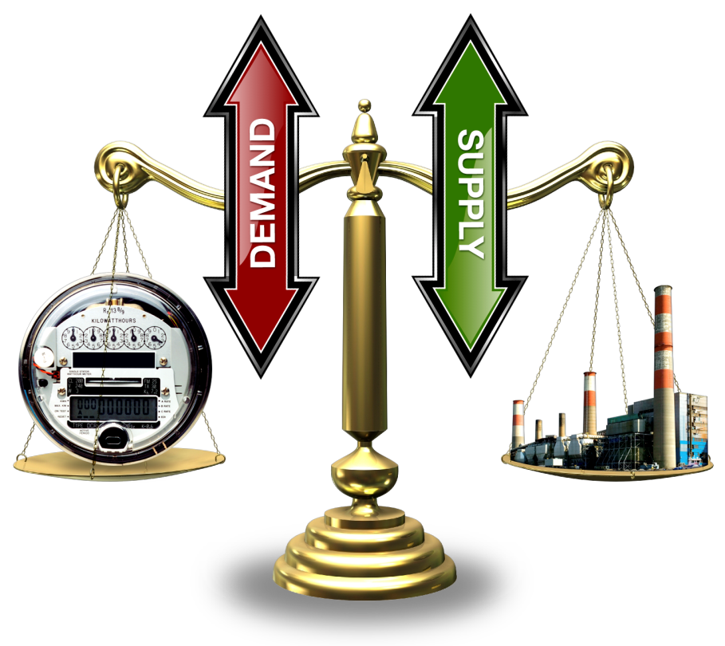
Part 1: What is Demand Response (DR)?
To maintain frequency on an interconnect power system it is necessary to maintain a balance between generation and load plus losses.
Traditionally the load has not actively participate in the balancing process.If you turn on the light switch when the power system is in a stressed condition you will still receive power.
Since the load does not actively participate it is necessary for the generators to account for all imbalances.

Slide 4
Market Concept
Bids submitted by two primary types
  Suppliers – bid in amount they can provide and what they want to charge for it
  Demanders – bid in amount they wish to use and how much they are willing to pay for it
Market closes and “clears”
  Bidding process is stopped
  Supply and demand bids are arranged
  Meeting point of the two curves is the “clearing price and quantity” of the auction

Slide 5
Price Elasticity of the End Use Loads
Price
Demand
(elastic)
Demand
Price
($/MW)
(inelastic)
Price, mitigated
Supply
Quantity (MW)
Notes:
Changing today's inelastic demand to dynamically respond to the market is broadly recognized as the key to stabilizing prices … and allowing lead time to add capacity at lower risk.
The technology to create a much more elastic demand curve must move quickly into the market, and dynamic markets for supply and demand must be created on many levels and scales.

Slide 6
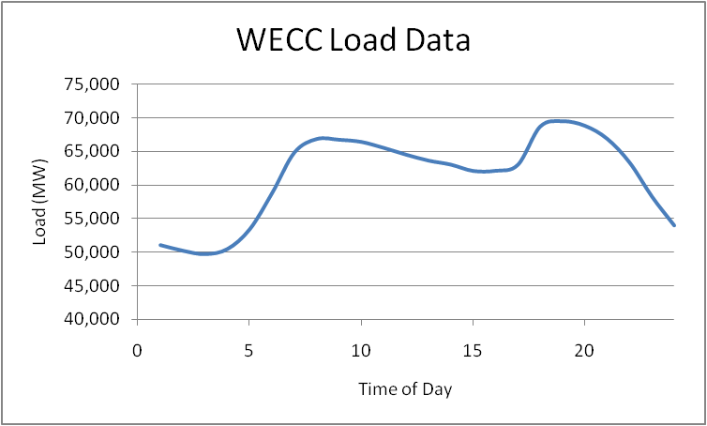
Demand Response cont.
Because the load is not an active participant in balancing, the rest of the electricity infrastructure has been designed and operated to account for this.
As a result, infrastructure has been constructed to accommodate peak system conditions, similar to a highway system.
In addition to the size of the system, operational methodologies have been implemented to account for the behavior of end use load.

Slide 7
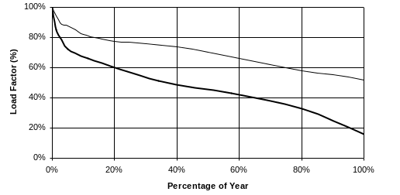
Utilization of Electricity Infrastructure
Hourly Loads as Fraction of Peak, Sorted from Highest to Lowest
90%
generation
75%
5% = ~400 hrs/yr
distribution
5%
(8,760 hrs)
25% of distribution & 10% of generation assets (transmission is similar),
worth of 100s of billions of dollars, are needed less than 400 hrs/year!
Notes:
Grid assets must be sized to meet peak demand, but their overall utilization over the course of the year is low.
These are load duration curves in which the loads for the year (hourly in this case) are sorted from highest to lowest.
When normalized to the peak load (100% load factor), they illustrate the utilization of an asset.
This plot shows the utilization of generation and a typical distribution feeder in the U.S.
Note that the average utilization (50-th percentile) for the year for generation is about 70%.
For distribution it is below 50%.
These do not include the reserve margins, which lower utilization of actual capacity substantially.
(CLICK) Note how much capacity is needed for only 5% of the hours of the year (438 hours):
(CLICK) 25% of our distribution capacity
(CLICK) and about 10% of our generation capacity exist only to serve loads for those few hours.
If we can displace those loads with demand response, distributed generation, and efficiency measures …
That would represent huge reductions in needed infrastructure.

Slide 8
Demand Response cont.
In order for Demand Response to be effective there must be a form of control input.
The input is often a control signal in the form of a price signal, which is sent by the utility or other controlling entity.
While price signals are one type of control signal, most any variable could potentially be used.

Slide 9
Demand Response cont.
Demand Response is the concept that end use loads can be active participants without impacting the end use customer.
With load as an active participate there are multiple benefits that can be obtained.
Demand Response can be used for:
  Peak load reduction
  Regulating services
  Emergency Conditions

Slide 10
Peak Load Reduction
Power systems exhibit non-linear characteristics which results in variable efficiencies.
  Under heavy loading conditions losses are higher due to non-linear I²R losses.
  During peak times less efficient “peaking units” may need to be run.
As a result, systems with high peak load characteristics are less efficient and more expensive to operate.

Slide 11


Peak Load Reduction cont.
Line Losses
Generator Efficiencies
For a typical power line, if you double the load, you will quadruple the losses.
Heat Rate: The number of British Thermal Units (Btu) required to produce a kWh of electrical power.
Coal Steam: 10,818 Btu/kWh
Combined Cycle: 8,931 Btu/kWh
CT/Diesel: 11,667 Btu/kWh

Slide 12
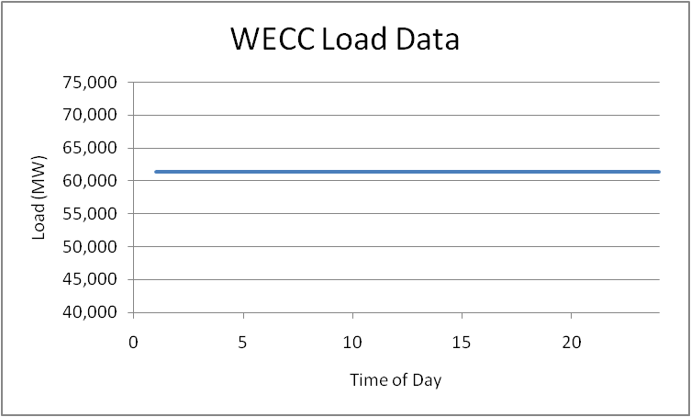
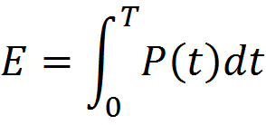
Optimal Peak Reduction
Because the load is not an active participant in balancing, the rest of the electricity infrastructure has been designed and operated to account for this.
As a result, infrastructure has been constructed to accommodate peak system conditions, similar to a highway system.
If the load is “smoothed” then the same energy could be delivered with less infrastructure.

Slide 13
Realistic Peak Reduction
It is not realistic to expect that the load can be completely flattened.
Because of the non-linear characteristics of power systems reducing the highest peaks will yield the greatest benefits.
Engaging Demand Response only at peak times will yield some of the most significant benefits, while affecting the end use consumers the least.

Slide 14
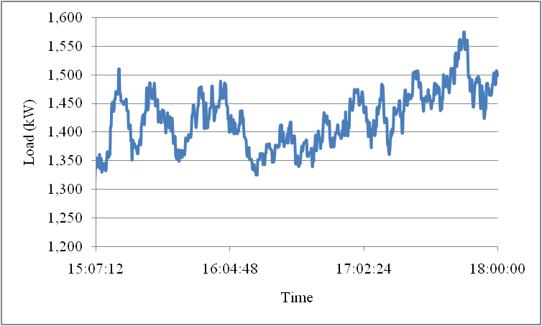
Regulating Services
On a typical distribution feeder the load will exhibit variations at different frequencies.
In order to maintain the generation-load balance generators must change their output continually.
Demand response can potentially be used to “smooth” the fluctuations by providing regulating services.

Slide 15

Emergency Conditions
Blackout are complicated processes involving millions of components.
Heavy load conditions are often cited as contributing factors to cascading blackouts.
Currently, there is no feedback to tell the customer that turning on a load is endangering a system which is stressed.
Demand response can be used to reduce load automatically in order to prevent a large scale cascading blackout.

Slide 16
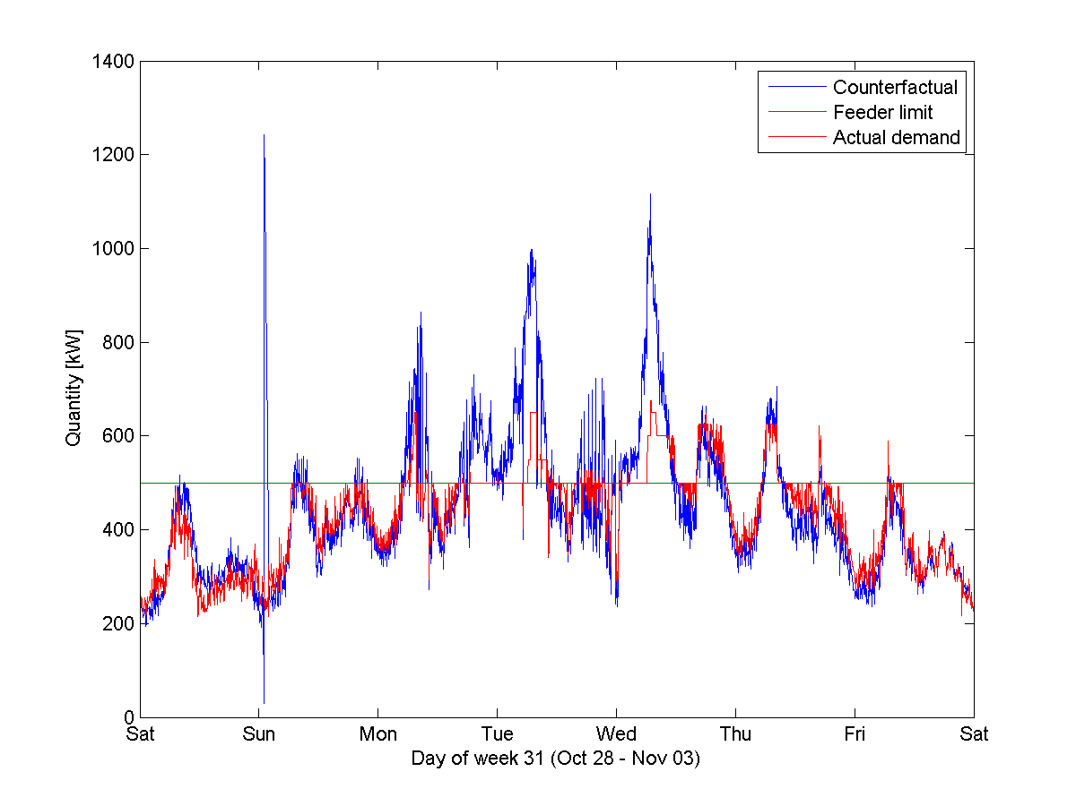
What are we trying to do?
Managing an Actual Distribution Constraint from
the Olympic Peninsula Demonstration
Unless DG or storage are present, there is no way to serve load above capacity!
feeder capacity

Slide 17
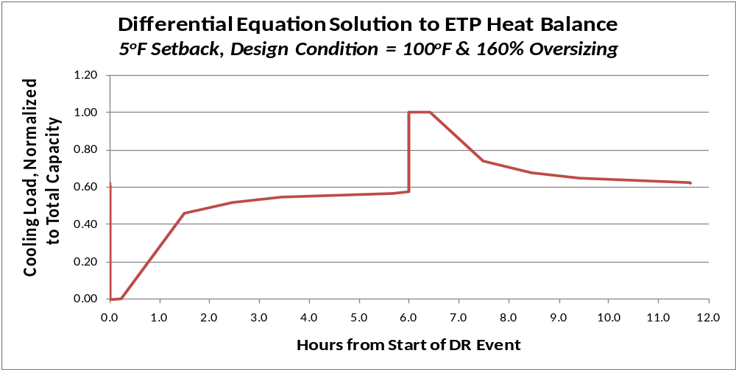

How do we manage the response?
The key challenge for DR is managing the rebound!
Initially AC = 0 (~20 min)
Rises to ~80% of initial load (~1 hr), ~93% at steady-state
Cooldown load at full capacity (~1/2 hr) – “rebound” effect
Ongoing cooldown to 125% of initial load (~1 hr)

Slide 18
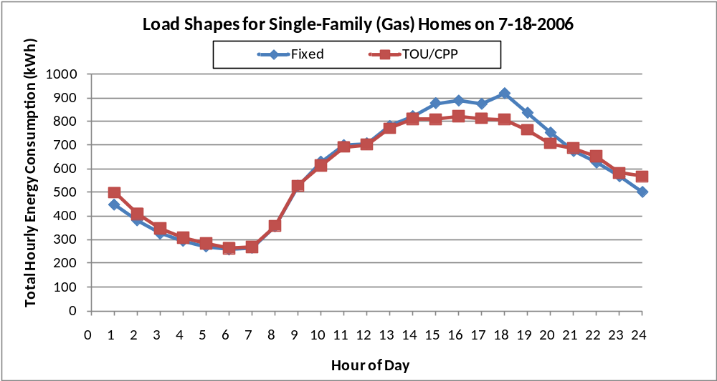
What can GridLAB-D do?
11.5% load reduction on peak day
However, this was accomplished by rotating TOU prices

Slide 19
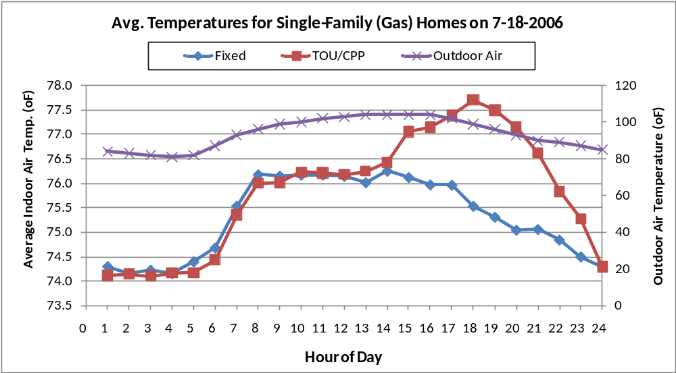
What are the effects to the customer?
TOU/CPP homes offered ~2ºF average increase in thermostat setting for 6 hours during peak
Unintended consequence: high CPP prices swamped Tstat

Slide 20
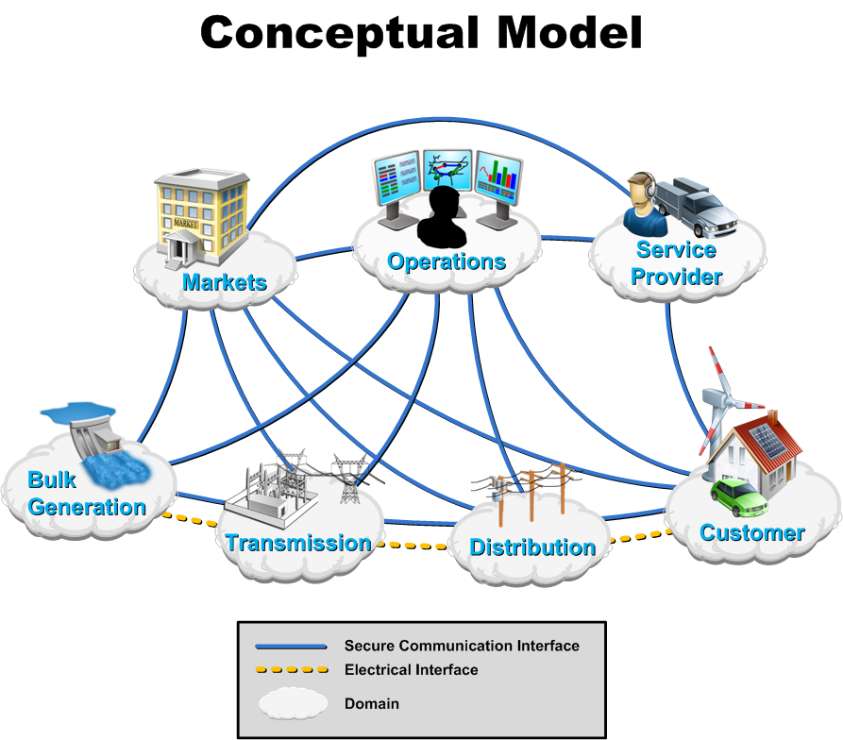
The Wide World of DR

Slide 21
Types of Load Control
Direct Load Control
Demand Response
  Time Of Use (TOU)
  Critical Peak Price (CPP)
  Real Time Price (RTP)
    Passive
    Double Auction
Distributed Control (Grid Friendly Appliances)

Slide 22
Direct Load Control
In a direct load control scenario the utility has a direct control path to the appliance controller.
Once the permission of the end user is obtained, the utility can control the end use load within the limits of a contract.
The end user is then given a monetary rebate for allowing this type of control.
Utilities like this type of system because there is a “big red button” that they can push and they know exactly how much load will respond.

Slide 23
Time Of Use (TOU)
Time Of Use can be implemented in 2 ways:
  Through a social system.
  Through a hardware system.
The social system informs the customer that electricity costs different amounts at different times and lets the end user adjust to this fact.
In the hardware system the price changes and the appliance will response immediately.

Slide 24
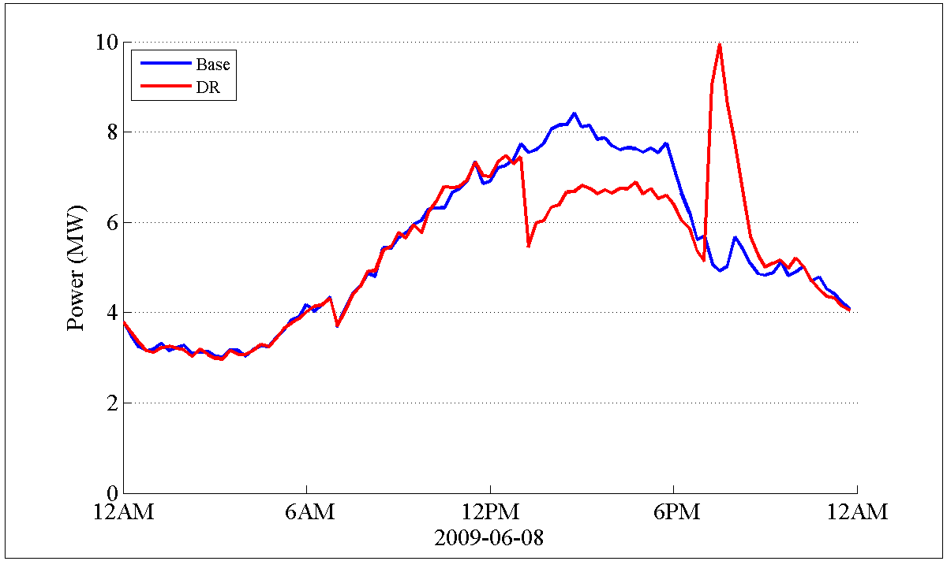
Demand Response Rebound

Slide 25
Demand Response Rebound
Demand response operates by adjusting the consumption of energy
  For a thermostat this results in a warmer (cooler) residence
  For a hot water heater this results in a lower water temperature
There must be a thermal mass or a process to defer
In either case there is a limited resource
  The HVAC system can defer operation but it must eventually turn on
  A dryer can operate at a lower temperature, but eventually the necessary energy must be consumed to dry the clothes
  The magnitude of the resource depends on technical as well as social limits/preference
With a Time of Use (TOU) or Critical Peak Price (CPP) a rebound can be experienced

Slide 26
Demand Response Rebound (cont.)
TOU and CPP can be implemented in 2 ways
      Socially: people are told of the TOU rate structure
      Hardware: signals are sent to hardware (appliances or home EMS)
With a social implementation a rebound is less likely
With a poorly designed hardware implementation, it is likely
One method to avoid the rebound effect is to implement a full Real Time Price (RTP) with a double auction
      RTP is technically effective
      RTP is hardware intensive

Slide 27
Critical Peak Price (CPP)
A CPP system generally operates as a TOU system, except for certain times of the year.
Given notice, customers are subjected to a CPP which is extremely high with respect to the normal prices.
This signal is used to offset the impacts of severe weather or fluctuations in fuel prices.
The utility is only allowed to declare a CPP a fixed number of times, so they must select them carefully.

Slide 28
Real Time Price (RTP)
A real time price is similar to a TOU price with a hardware implementation except that the price can change every 5 minutes.
Because it changes so often it is necessary to implement this with hardware.
A RTP is a more accurate representation of the true cost of consuming electrical energy.

Slide 29
Real Time Price (RTP) cont.
An RTP can represent many different components of a power system.
It can also be an aggregate “signal” with inputs from multiple sources.
  Wholesale power cost
  Transmission level congestion cost
  Distribution level congestion cost
  Regulation cost
By using different components in a cost signal many stakeholders can be represented without the end user having to understand the complexity of a power system.
The price signal sent to the end user may not be the actual cost of power, but a number which indicates the relative cost of power at a given time.

Slide 30
RTP-Double Auction Market
Price
Demand
(elastic)
Demand
Price
($/MW)
(inelastic)
Price, mitigated
Supply
Quantity (MW)
Notes:
Changing today's inelastic demand to dynamically respond to the market is broadly recognized as the key to stabilizing prices … and allowing lead time to add capacity at lower risk.
The technology to create a much more elastic demand curve must move quickly into the market, and dynamic markets for supply and demand must be created on many levels and scales.

Slide 31
RTP-Double Auction Market
A double auction has the advantage that rebound effect will not be experienced.
A true double auction can address many issues at once, and include bidding from load, central generation, and distributed generation.
When a market is “cleared” there can be issues of equitable solutions.
A double auction market requires a significantly more capable communications system than a RTP system.

Slide 32
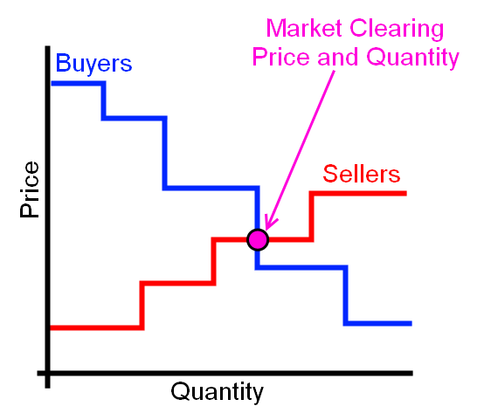
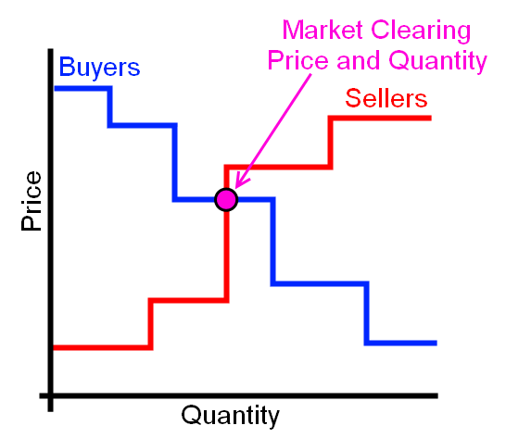
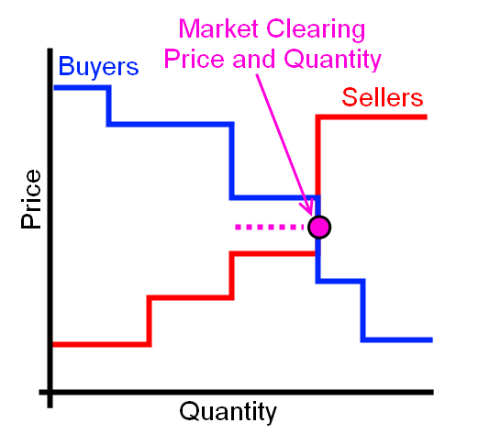
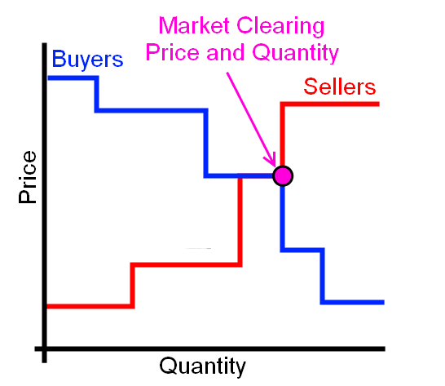
Market Clearing

Slide 33
Market Objects
Controller
Auction
Used to create a two-way, transactive bidding market.
Passive Controller
Stub Auction
Used for delivering prices to a purely reactive controller.
Note: Passive controller can be used with an auction, or a number of other objects.

Slide 34
Auction and Controller Objects
Auction Objects
Controller Objects
For a distribution feeder there is generally only a single auction object.
Object collects bids, clears the market, and delivers cleared prices to the controller objects.
A player is generally needed to input a price signal for TOU, CPP, or RTP.
A controller object must be placed on every device which will participate in the market.
A controller can be on a thermostat, a hot water heater, or any other load.
It tells the market how the load is willing to behave and modifies the load behavior as a function of cleared price.

Slide 35
Stubauction Object
The auction is responsible for determining the clearing price.
In a stub-auction there is no clearing of the market, the clearing price is input through a .player file.
object stubauction {
name Market_1;
period 300;
object player {
file Price.player;
property current_market.clearing_price;
};
object recorder {
property avg24,std24;
limit 2880;
interval 60;
file price_statistics.csv;
};
}

Slide 36
Passive Controller – HVACs
(Thermostat)
k
k
Price*
P_{avg}
P_{clear}
T_{min}
T_{set}
T_{desired}
T_{current}
T_{max}
Temperature

Slide 37
Passive Controller - HVAC
The passive controller does not send a bid signal to the market.
This implies unidirectional communications.
This controller is set for a 24 hour moving window for market values.
The moving window can be changed to any value.
Ramp and Range values set the “responsiveness” of the passive controller.
object passive_controller {
base_setpoint cooling3*1;
control_mode RAMP;
sensitivity 1;
expectation_obj Market_1;
expectation_prop avg24;
setpoint_prop cooling_setpoint;
state_prop override;
observation_obj Market_1;
observation_prop current_market.clearing_price;
mean_observation_prop avg24;
stdev_observation_prop std24;
range_low -1.500;
range_high 2.500;
ramp_low 1.333;
ramp_high 0.800;
}

Slide 38
Price Player
2000-01-01 00:00:00,0.065139609
+1h,0.063279907
+1h,0.047926635
+1h,0.054980748
+1h,0.054144897
+1h,0.052692165
+1h,0.025675894
+1h,0.048756545
+1h,0.060731834
+1h,0.067444366
+1h,0.077139106
+1h,0.115129386
+1h,0.314471806
+1h,0.103280668
+1h,0.107517265
+1h,0.090978092
+1h,0.099465131
+1h,0.163445608
+1h,0.188779549
+1h,0.122554232
+1h,0.281734869
+1h,0.240559158
+1h,0.082833806
+1h,0.081005661
+1h,0.062340608
+1h,0.058395271
The price.player file reads a price into the auction object.
This price is used to represent the cleared price of power for a TOU or RTP market structure.
The example shows price in 1 hour time steps, but smaller or larger time steps can be used.
A price signal is then sent to every control and based on this signal and the controller values.
The load will then respond accordingly.

Slide 39
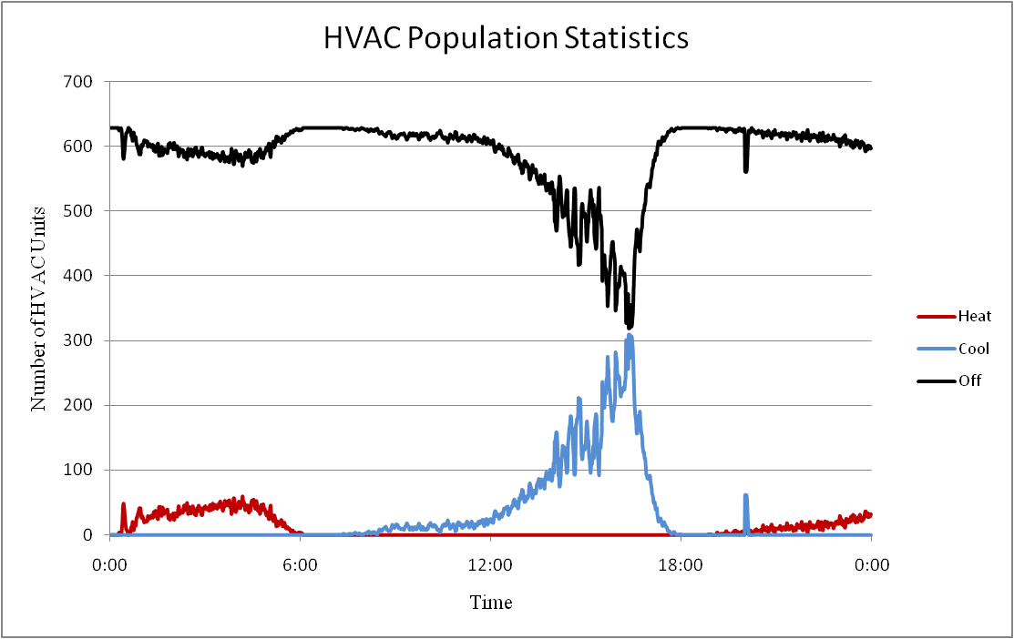
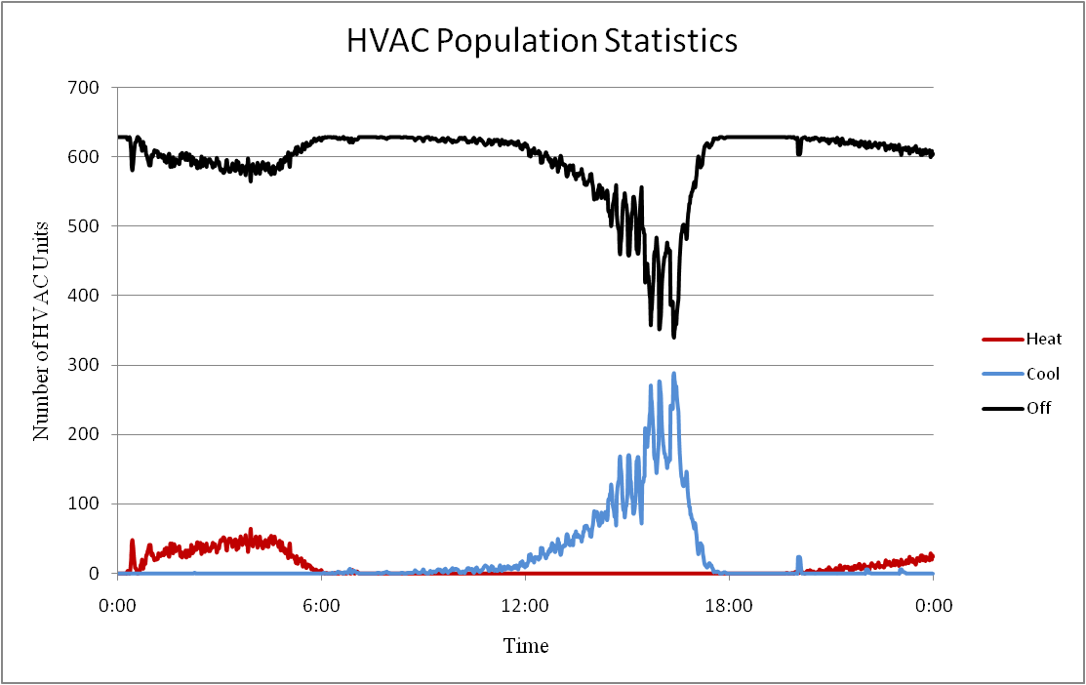
Population Statistics
At any given time in a system an HVAC unit will be in one of 4 operating modes.
  Off
  Cooling
  Heating
  Heating (AUX)
A control signal will distort these population statistics.
Multi-state physical models are used in the simulation so that we can understand how the control signal is distorting the statistics, and thus the power consumption.

Slide 40
DLC in GridLAB-D
HVACs - Cycling
Water Heaters - Probabilistic
object passive_controller {
control_mode DIRECT_LOAD_CONTROL;
dlc_mode CYCLING;
cycle_length_on 803;
cycle_length_off 917;
state_property override;
observation_object Market_1;
observation_property past_market.clearing_price;
second_tier_price 0.680986;
};
object passive_controller {
period 900;
control_mode PROBABILITY_OFF;
distribution_type NORMAL;
observation_object Market_1;
observation_property past_market.clearing_price;
stdev_observation_property my_std;
expectation_object Market_1;
expectation_property my_avg;
comfort_level 9999.00;
state_property override;
};
Pool Pumps - Off
object passive_controller {
control_mode DIRECT_LOAD_CONTROL;
dlc_mode OFF;
state_property override;
observation_object Market_1;
observation_property past_market.clearing_price;
second_tier_price 0.680986;
};

Slide 41
Price Elasticity
Used to represent the change in customer load due to a change in price.
In GLD, typically used to represent loads that do not have automated DR controls (e.g. dryers).
Based on PRISM¹ models.
  Empirically based – data typically comes from previous field studies.
¹A. Faruqui and L. Wood, “Quantifying the Benefits of Dynamic Pricing in the Mass Market”, The Brattle Group, Prepared for Edison Electric Institute, January 2008.

Slide 42
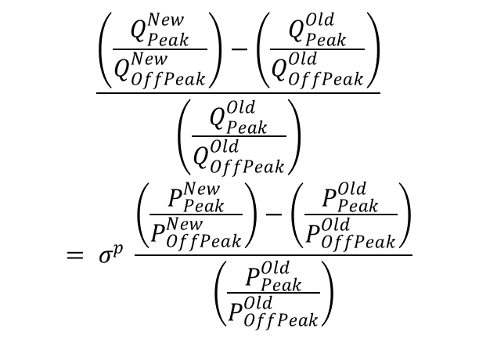
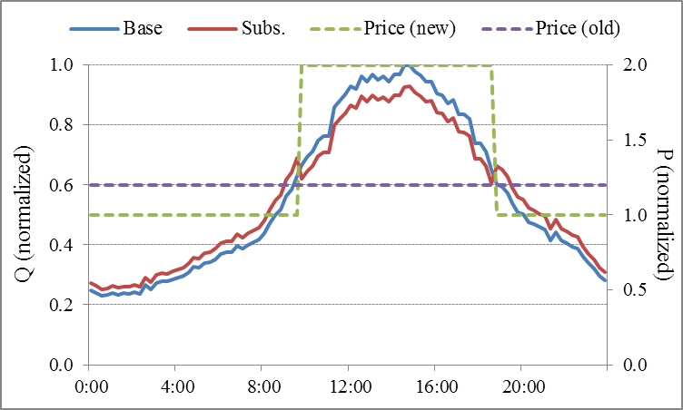
Price Elasticity Model
Substitution Elasticity
  Customer’s willingness to shift their energy usage from on-peak to off-peak time periods (deferred energy usage).

Slide 43
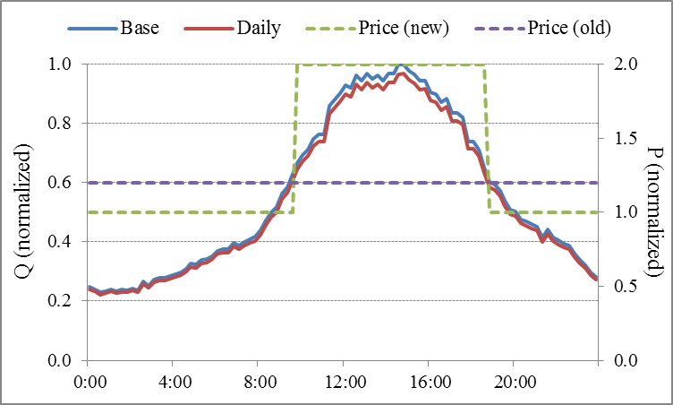
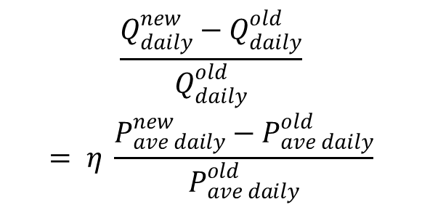
Price Elasticity Model (cont.)
Daily Elasticity
  Customer’s willingness to decrease (or increase) daily energy consumption in response to a change in price.

Slide 44
Elasticity in GridLAB-D
object passive_controller {
period 900;
control_mode ELASTICITY_MODEL;
two_tier_cpp true;
observation_object Market_1;
observation_property past_market.clearing_price;
state_property multiplier;
linearize_elasticity true;
critical_day CPP_days_R1.value;
first_tier_hours 12;
second_tier_hours 12;
third_tier_hours 6;
first_tier_price 0.069987;
second_tier_price 0.139973;
third_tier_price 0.699867;
old_first_tier_price 0.124300;
old_second_tier_price 0.124300;
old_third_tier_price 0.124300;
daily_elasticity -0.1305;
sub_elasticity_first_second -0.0198;
sub_elasticity_first_third -0.0290;
}
The passive controller does not send a bid signal to the market, as it is representing human behavior (child of a ZIPload).
Can represent either 2-rate or 3-rate plus CPP.
Each rate period has it’s own elasticity in comparison to lowest rate period.
Negative elasticity represents less energy consumption (daily) and less energy consumed during critical period (substitution).
Updates percent load change every market period.

Slide 45
Auction Objects
object auction {
string name;
string unit; //i.e. MW, kW, or kWh
integer period[s]; //Interval between market clearings
integer latency[s]; //Lag between clearing and delivery
string special_mode; //Allows for buyer or seller only
double pricecap; //Maximum bid price allowed
boolean verbose; //Allows user to watch bidding
double init_price; //Used to “bootstrap” market if warmup=TRUE
double init_stdev;
object capacity_reference_object; //more details following
integer warmup; // 1=TRUE, 0=FALSE
}
Defines market intervals
Provides clearing price and quantity after clearing, average prices, and standard deviation
Allows for active bidding from buyers and sellers
Also available – previous and current market clearing statistics such as marginal quantity, marginal load, etc.

Slide 46
Auction Objects
The statistical interval desired must be created by the user in the following form:
  class auction {
  double yyyy_price_mean_xx;
  double yyyy_price_stdev_xx;
  }
Where “yyyy” can be “current” or “past” and “xx” can be “#m”, “#h”, “#d”, or “#w”:
  class auction {
  double past_price_mean_5d;
  double current_price_stdev_3m;
  }
Any number of statistics can be created and used by various objects

Slide 47
Auction Objects
Available auction outputs:
  user specified statistics
  current_market.clearing_price
  current_market.clearing_quantity
  past_market.clearing_price
  past_market.clearing_quantity
  clearing case type

Slide 48
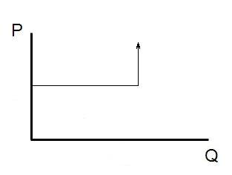
Capacity Object
Acts as a selling agent to limit power flowing through object (or other properties)
If below capacity, market should clear at bid price
If at/above capacity, should clear to limit quantity
Seller bid is a user-defined quantity and typically an RTP price signal
Buyer bid is the estimate of the unresponsive load as the quantity and price cap
to pricecap
Seller bid
Load bid
Unresponsive load
Responsive or bidding load

Slide 49
Example Capacity Object
object auction {
name Market_1;
type DOUBLE;
unit kW;
period 300;
// Initial statistics to stabilize initial market
init_price 35.0001;
init_stdev 10;
warmup 1;
// looking at the feeder regulator and power flowing through
capacity_reference_object 1406_regulator;
capacity_reference_property power_out_real;
capacity_reference_bid_price seller1*1;
max_capacity_reference_bid_quantity 125; //kW
}

Slide 50
Bidding Function
Once an auction has been established, objects can submit bids
submit_bid function structure
  Market to bid into
  Object that is bidding
  Quantity to bid
  Price of bid

Slide 51
Clearing of the Market
Previous values stored in past_market.clearing_price and past_market.clearing_quantity
Current cleared values stored in current_market.clearing_price and current_market.clearing_quantity
Output values can be seen via recorder or directly delivered to a controller object

Slide 52
Controller Objects
object controller {
string control_mode; //RAMP or DOUBLE_RAMP
string market; //Name of auction object to be used
string parent; //Object modified by controller
string setpoint; //Set point to be modified by controller
string base_setpoint;//Desired set point value
string target; //Value set point is compared against
integer period[s];
string demand; //Bid quantity of object
boolean verbose;
string bid_mode;
string simple_mode; //Various “easy” connections to appliances
property average_target;
property standard_deviation_target;
…
}
Provides an interaction point between loads and market.
Uses various external inputs to determine a bid_quantity and bid_price for the object it is attached to.

Slide 53
Controller Objects - Ramp
object controller {
…
control_mode RAMP;
double range_low;
double range_high;
double ramp_low;
double ramp_high;
double slider_setting_heat; //Simple pre-set slider 0-100%
double slider_setting_cool; //participation in market (DOUBLE_RAMP)
double slider_setting; //(RAMP) – sets ranges and ramps
}
Control mode is dependent upon the object to be controlled
Determines how the object bids and how it responds to a specific price
RAMP and DOUBLE_RAMP modes control thermostatic set points

Slide 54
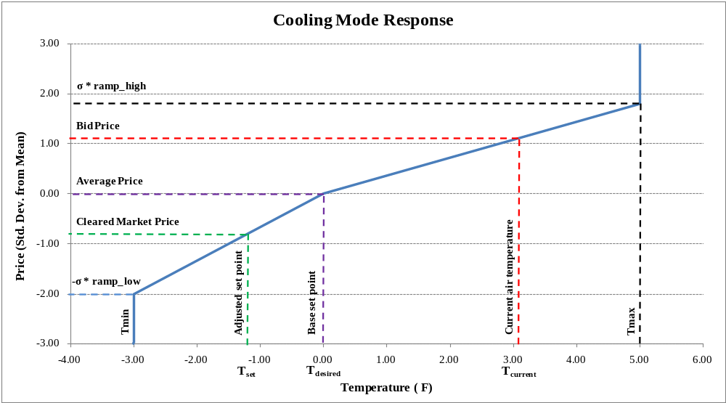
Controller Objects - Ramp

Slide 55
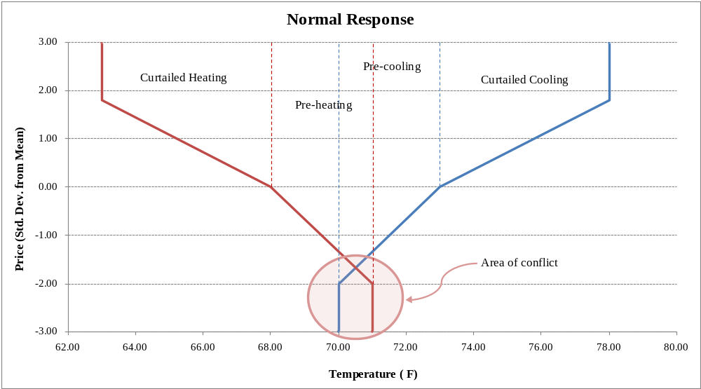
Controller Objects – Double Ramp
Normal action could cause conflicting pre-cooling and pre-heating states
DOUBLE_RAMP provides two means for resolving this conflict (deadband and sliding)

Slide 56
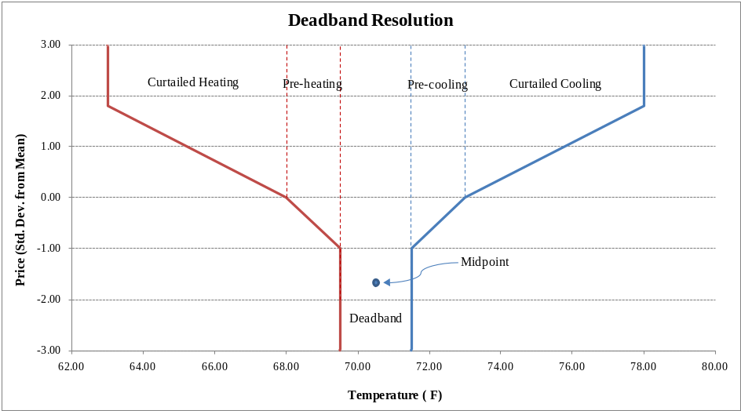
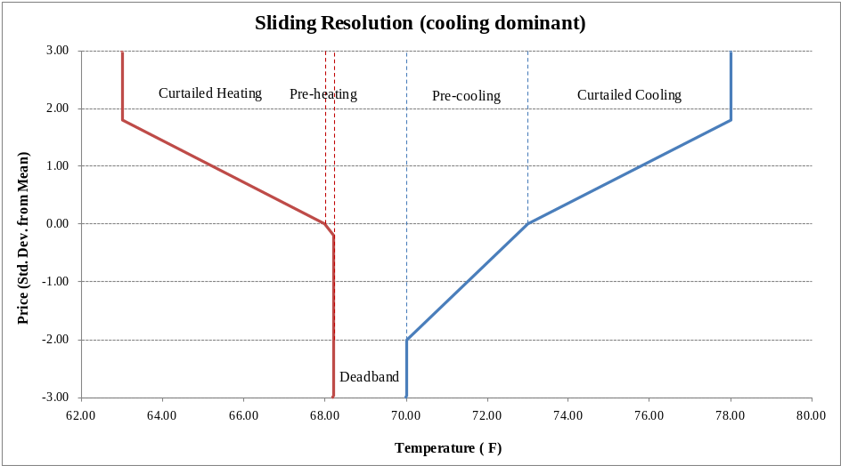
Controller Objects – Double Ramp
deadband resolution essentially limits the range of the pre-cooling and pre-heating and determines an average amount.
sliding resolution determines which mode (heat or cool) was last used, and allows this to override the other.

Slide 57
Controller Objects
object passive_controller {
string control_mode; //RAMP, PROBABILITY_OFF, others are unfinished
string mean_observation_property;
string stdev_observation_property;
string expectation_object;
string expectation_property;
string observation_object;
string observation_property;
string parent;
string setpoint;
string base_setpoint;
string setpoint_property;
string state_property;
integer period[s];
enum distribution_type; //NORMAL, UNIFORM, EXPONENTIAL (PROB_OFF)
double comfort_level; //0-inf (PROB_OFF)
double range_low/high, ramp_low/high; //(RAMP)
}
Responds to a signal (not just price), but does not bid into market.

Slide 58
Example controllers
object controller {
market Market_1;
bid_mode ON;
control_mode RAMP;
slider_setting 0.500;
base_setpoint cooling7*1;
period 300;
average_target current_price_mean_24h;
standard_deviation_target current_price_stdev_24h;
target air_temperature;
setpoint cooling_setpoint;
demand last_cooling_load;
total hvac_load;
load hvac_load;
state power_state;
range_high 5;
range_low -3;
};
object controller {
market Market_1;
bid_mode ON;
control_mode DOUBLE_RAMP;
resolve_mode DEADBAND;
slider_setting_heat 0.500;
slider_setting_cool 0.500;
heating_base_setpoint 68;
cooling_base_setpoint 74;
period 300;
average_target current_price_mean_24h;
standard_deviation_target current_price_stdev_24h;
target air_temperature;
heating_setpoint heating_setpoint;
heating_demand last_heating_load;
cooling_setpoint cooling_setpoint;
cooling_demand last_cooling_load;
deadband thermostat_deadband;
total hvac_load;
load hvac_load;
state power_state;
};
object passive_controller {
period 300;
control_mode PROBABILITY_OFF;
distribution_type NORMAL;
observation_object Market_1;
observation_property current_market.clearing_price;
stdev_observation_property current_price_stdev_24h;
expectation_object Market_1;
expectation_property current_price_mean_24h;
comfort_level 1.00;
state_property override;
};

Slide 59
Customer Billing
Performed in triplex_meter (customer meter)
Three billing types: UNIFORM, TIERED, HOURLY (RTP)
Includes a monthly fee and bill processing day
bill_dump allows you to collect all bills in a single file
object triplex_meter {
bill_mode UNIFORM;
price 0.1; // $/kWh
bill_day 1;
monthly_fee 10; //$
}
object triplex_meter {
bill_mode HOURLY;
// name of the auction
power_market my_market;
bill_day 1;
monthly_fee 10;
}
object triplex_meter {
bill_mode TIERED;
price 0.1;
bill_day 1;
monthly_fee 10;
first_tier_energy 100;
first_tier_price 0.15;
second_tier_energy 500;
second_tier_price 0.18;
third_tier_energy 1000;
third_tier_price 0.20;
}
object bill_dump {
runtime ‘2000-01-01 00:00:00’;
filename my_bill_dump.csv;
}

Slide 60
Market Exercises
Using the IEEE 4-node, replace the load with a single home (don’t forget the transformer) with a double ramp HVAC controller. Create an auction object using 24 hour statistics in BUYER_ONLY mode. Observe the difference in demand when using different slider settings.
Add a water heater and a passive controller in probabilistic off mode. Observe the effect of the comfort level on demand.
Add billing to the customer meter and try the various billing types. Observe the differences in bills.
Observe the IEEE-13 node test system with markets.

Slide 61
DR Exercise 1
Run the CVR 13 Node system for 7 days with a constant price signal.
Plot the Regulator apparent power consumption, voltage at the regulator control node, price signals, and the HVAC system population statistics.
What is the peak load and how many HVAC units are in operation at this time?

Slide 62
DR Exercise 2
Run the CVR 13 Node system for 7 days with the default price signal.
Plot the Regulator apparent power consumption, voltage at the regulator control node, price signals, and the HVAC system population statistics.
How does the system operate with the price signal compare to without?

Slide 63
DR Exercise 3
Develop a control signal, i.e. price signal, that you think optimally controls the system. Explain your basis for this control signal.
Run the CVR 13 Node system for 7 days with the custom price signal.
Plot the Regulator apparent power consumption, voltage at the regulator control node, and the HVAC system population statistics.
How does this signal perform.
What is your opinion of a passive control signal?

